Slide 1


Slide 2
Overview
Reionization: What it is and why it’s important.
Galaxies + Reionization: How galaxies and the evolution of ionized hydrogen are intertwined.
My work: How I’ve explored the importance of the escape fraction on reionization.

Slide 3
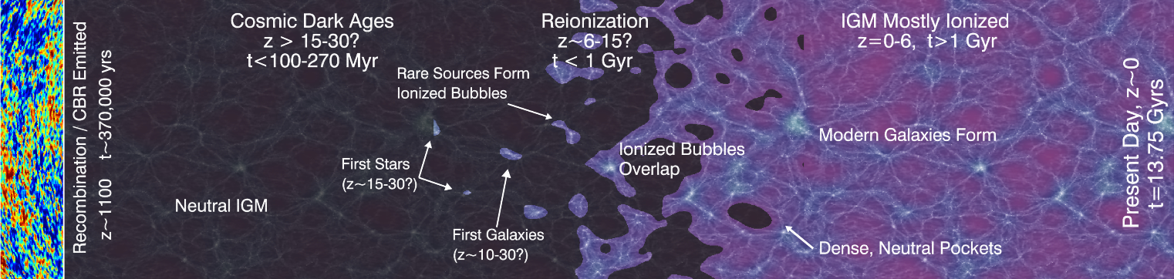
Epoch of Reionization
(Robertson, 2010)

Slide 4
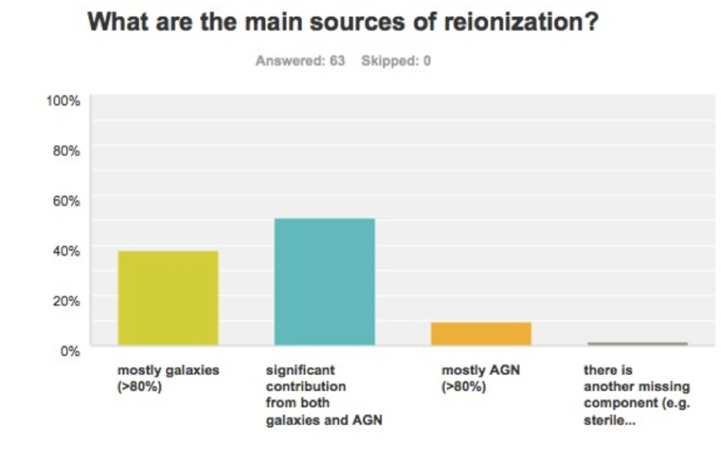
Sources of Reionization
Let’s only focus on galaxies.
(Fan, 2016)

Slide 5
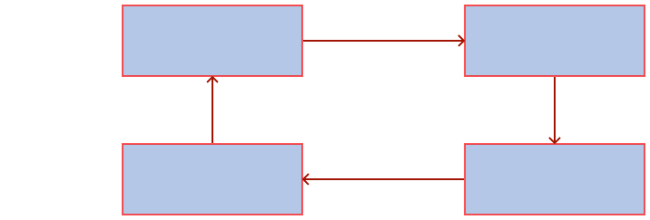
Galaxies and Reionization
Galaxy Forms Stars
Stars Emit Photons
Galaxy Accretes Matter
Photons Ionize IGM

Slide 6
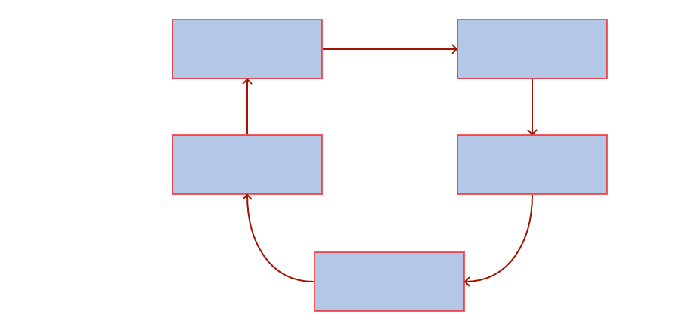
Galaxies and Reionization
Galaxy Forms
Stars
Stars Emit
Photons
Galaxy Accretes
Matter
Photons Ionize
IGM
IGM Suppresses
Accretion

Slide 7
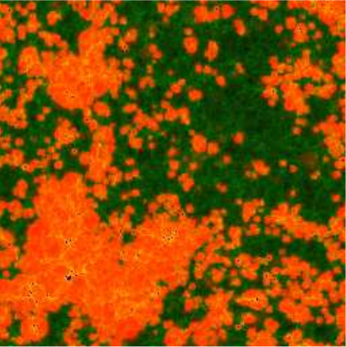
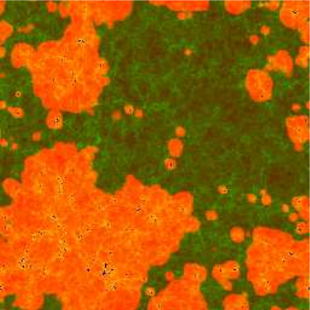
Effect of Suppression
Fiducial
z_{50%} = 9.8, z_{100%} = 8.5
No Suppression
z_{50%} = 13.9, z_{100%} = 12.9
(Iliev et al., 2012)
Notes:
Linking this to the next slide by saying

Slide 8
Galaxies and Reionization
Galaxy Forms
Stars
Stars Emit
Photons
Galaxy Accretes
Matter
Photons Ionize
IGM
IGM Suppresses
Accretion

Slide 9

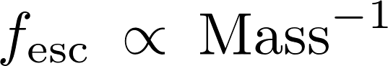

How does f_{esc} impact reionization?
The form of f_{esc} can drastically affect the topology and duration of reionization.

Slide 10
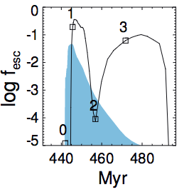
f_{esc} Depends On Galaxy Processes
Stellar feedback + Supernovae blowouts move gas to outskirts.
Photons can more easily escape into the IGM?
SN Blowout
Radiation Feedback
(Kimm et al., 2016)
Notes:
From zoom-in simulations that also included a sub-grid model of SFR.
M_Part approx 1000 Msun, L approx 4 h^-1Mpc. Spatial res approx 10pc.
These images show the most massive galaxy from a number of different runs. Highlights that there is significant variation in the escape fraction over time and that there is a slight delay between the peaks in SFR and the peaks in fesc.

Slide 11
My Aim
Can we model the interplay between galaxies and the evolution of ionized hydrogen?*
How does the topology change?
How does the duration change?
Can we observationally detect the effects?
(* Hopefully yes otherwise no Dr. Seiler in the future).
Notes:
Normally people just assume constant escape fraction, however this simiplifies a lot of things (as we just saw). As a consequence, are we able to determine a more physical form of the escape fraction that still agrees with general EoR things?

Slide 12
Takes Two To Tango
Evolve a galaxy population through cosmic time.
Need to track their properties for f_{esc}.
Needs to be quick so we can test the effects of supernova/AGN/etc feedback.
Simulate the evolution of neutral hydrogen.
Needs to be quick so we can test different f_{esc} choices.
Notes:
Normally people just assume constant escape fraction, however this simiplifies a lot of things (as we just saw). As a consequence, are we able to determine a more physical form of the escape fraction that still agrees with general EoR things?

Slide 13
Semi-Analytic Models
Cold Gas
Star Formation
Cooling
Supernovae Heating
Hot Gas
Incorporation
Ejected Gas
Supernovae Ejection
Infalling Gas
(including
reionization feedback)
+ Black Hole Growth
+ Merger/Disruption Events
+ Bulge Growth
Notes:
Give an overview of how SAMs work. “SAMs work by moving mass through different reservoirs depending upon coupled DEs. The processes are (e.g. supernovas heat cold gas etc etc).”

Slide 14
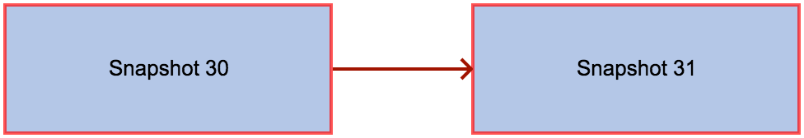
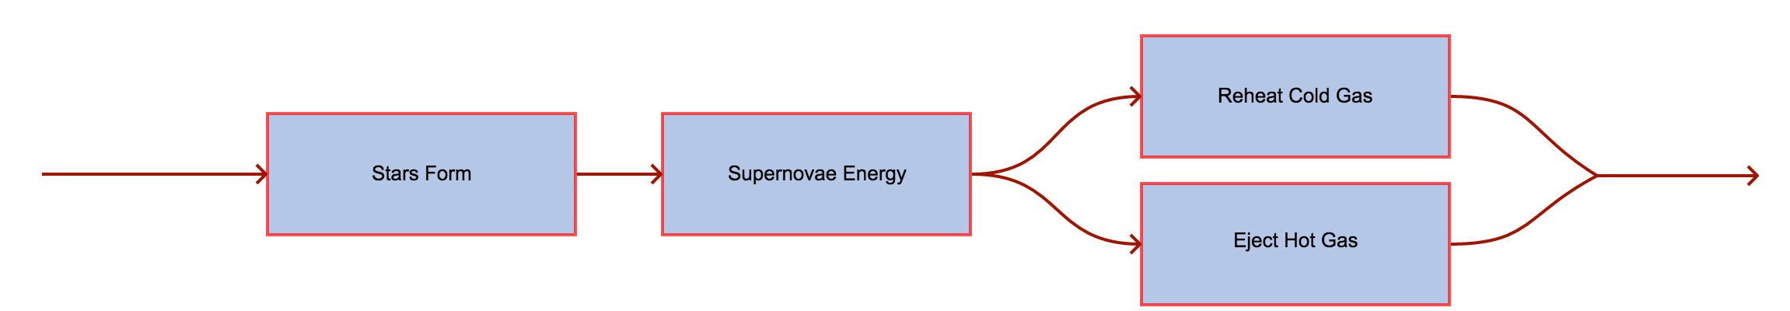
Supernova Feedback
Only valid if snapshots span ~40Myr
Notes:
Normally people just assume constant escape fraction, however this simiplifies a lot of things (as we just saw). As a consequence, are we able to determine a more physical form of the escape fraction that still agrees with general EoR things?

Slide 15
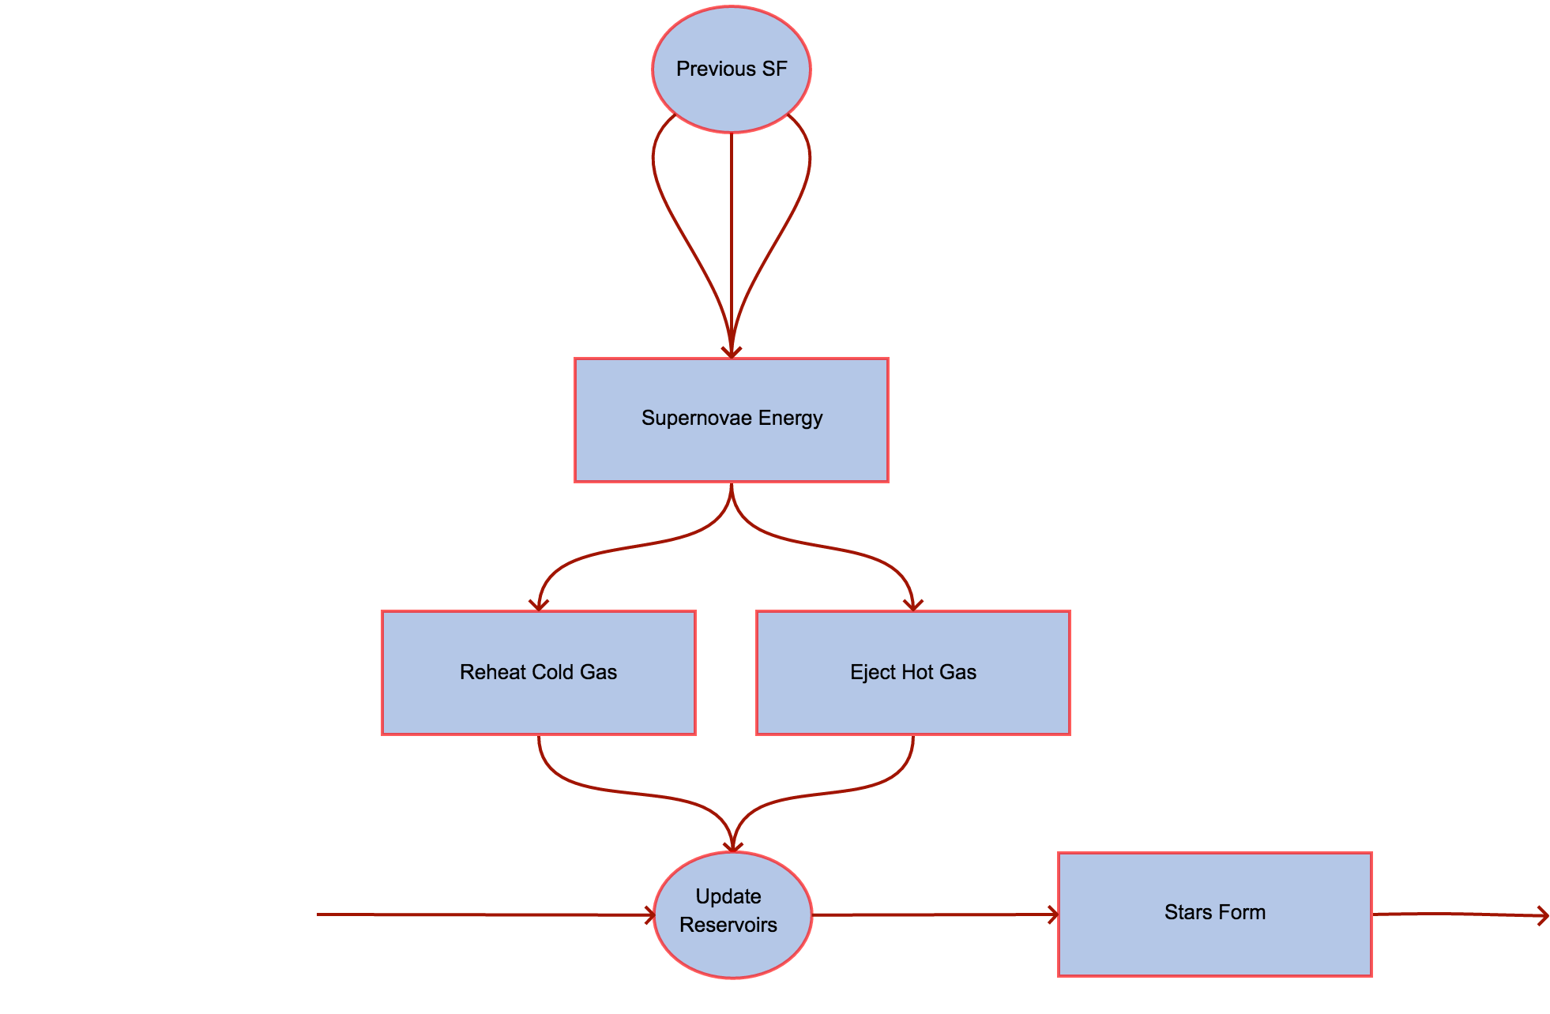
Notes:
Normally people just assume constant escape fraction, however this simiplifies a lot of things (as we just saw). As a consequence, are we able to determine a more physical form of the escape fraction that still agrees with general EoR things?

Slide 16

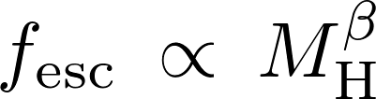




Escape Fraction Parameterization
Sample Text
Notes:
Final ingredient is the escape fraction. In this work we focus on 3 different parameterizations. As we saw the halo mass is thought to affect the escape fraction so we use a power law. We fix the escape fraction for the least and most massive halos that then defines our slope + intercept. The ejected mass is an attempt to model how SN are seen to affect the escape fraction. Fix the smallest and largest escape fraction and then define a linear relationship.
But because of the power of the SAM we can really be crazy and parameterize the escape fraction however we want. These are just a few examples.

Slide 17
Ionizing Photons
Notes:
Link back to observations. Explain contours properly. What we do and don’t know about obs

Slide 18

Modelling Reionization
0
0
0
0
1e52
1e51
0
0
0
0
0
9e51
Draw spheres and count the number of ionizing photons + neutral H + recombinations.
0
0
0
1e52
1e52
0
0
0
0
0
1e52
0
0
0
2e52
0
0
0
7e51
0
0
0
0

Slide 19
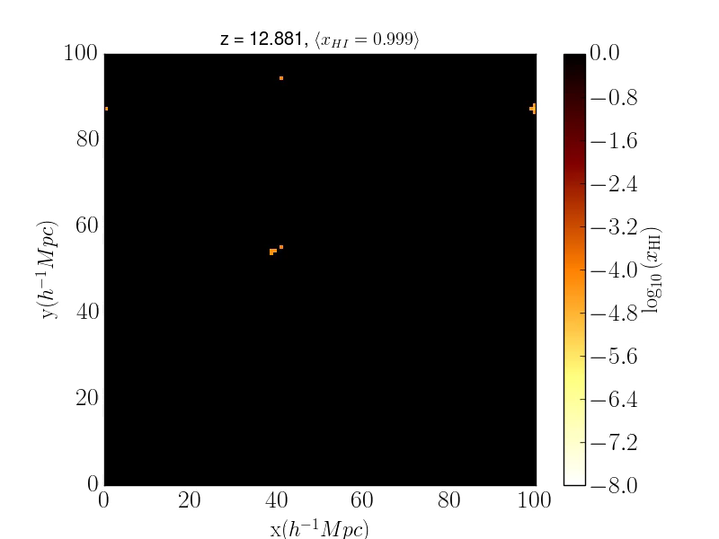
Preliminary Results
Notes:
A previous talk has hopefully talked about SAMs; if they haven’t give a brief description. On the left is the SMF which we can see agrees to an acceptable level with the observations. On the right we see that the rate of ionizing photons reaches a plateau after ~5 Myr. This is a linear relationship that depends upon the SFR which is how we determine the number of ionizing photons emitted by each galaxy.
Finally highlight that SAMs take a short amount of time to run; easy to explore parameter space!

Slide 20
Preliminary Results
Notes:
Link back to observations. Explain contours properly. What we do and don’t know about obs

Slide 21
Preliminary Results
Notes:
Link back to observations. Explain contours properly. What we do and don’t know about obs

Slide 22
The Next 12 Months
Quantify the difference between morphology + duration of reionization for different f_{esc} prescriptions.
Paper 1: “Morphology of ionized regions under various escape fraction parameterizations”.
Turn our results into observables (21cm signal) that telescopes can measure.
Paper 2: “21cm forecasting to determine the escape fraction”.
Notes:
Basically just read the slide and give a summary. Ez pz.

Slide 23
Timeline
August 2017: Mid-candidature review
August 2017: Finalize N-body simulation and construct merger trees
September-October 2017: Initial comparison for different escape fraction prescriptions
Submit first paper
September-December 2017: Use g2 computational time to run suite of simulations
Preparation of second paper
February 2018: Second paper submission
March 2018: Third paper preparation
August 2018: Pre-submission review
October 2018: Third paper submission
February 2019: Thesis submission.

